Slide 1
AI for Everyone: The Basics of Supporting Educators and Learners Presenter: Dr. Michelle Pierson

Slide 2
Reading the Room
Who’s in the Room?
AI and You
Generative AI-What is It?
Trends in AI for Students
Practical Tools and Uses
Takeaways/Questions
Additional Helpful Resources/Links

Slide 3
Who's in the Room? In the Chat, please type -Name -Position at Mercer -First word that comes to mind about AI

Slide 4
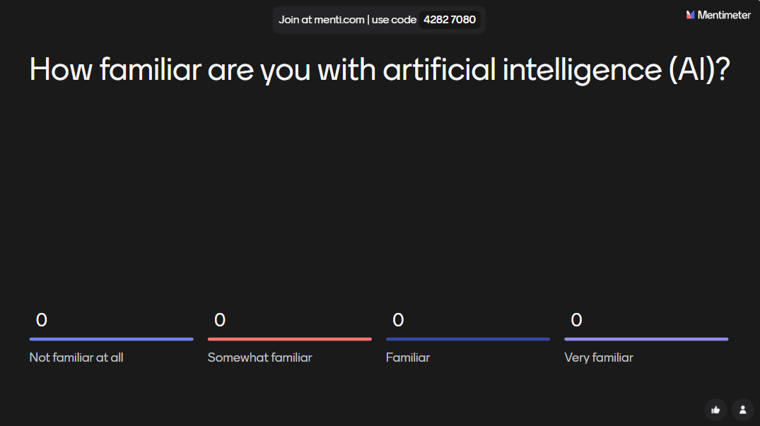
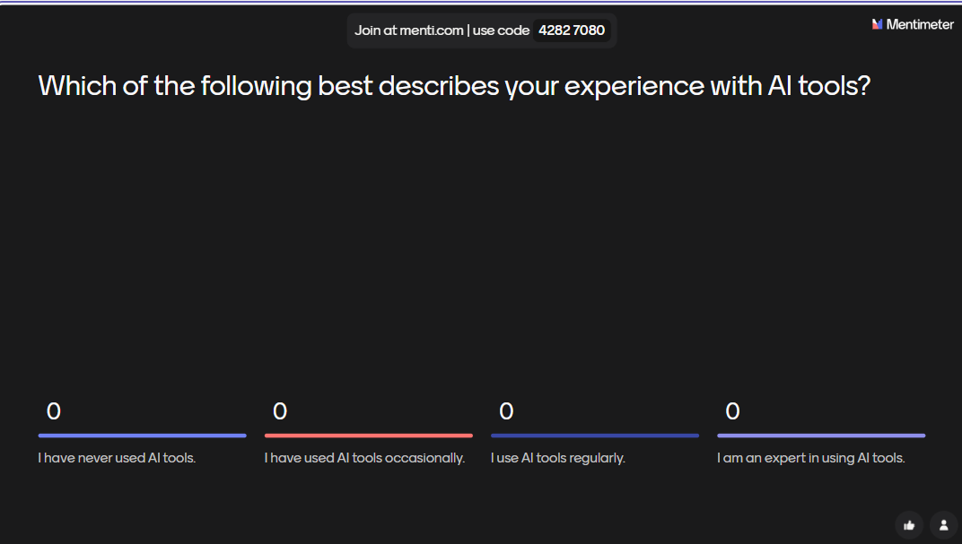
AI and You-Where Are You?
https://www.menti.com/alrqwbwx629w

Slide 5
What is Generative AI?
• AI that creates content: text, images, audio, video, code
• Examples: ChatGPT, DALL·E, Bard
• Based on large language models trained on massive data sets

Slide 6
How It Works (Simplified)
• AI is trained on huge data sets
• It learns patterns in language, images, or code
• It generates new content based on user prompts

Slide 7
Trends in AI-Students Say...

Slide 11
Chronicle of Higher Ed- April 2025 Issue
An OpenAI analysis found that about half of students ages 18 to 24 use AI for
starting papers or projects
summarizing long texts
brainstorming projects
exploring topics
revising writing
To a lesser degree they also use it
to solve math problems
prepare for exams
write computer programs
create lesson plans
learn languages
ask advice
search for jobs
organize their schedules
do career-related writing

Slide 12
Practical AI Tools and Uses

Slide 13
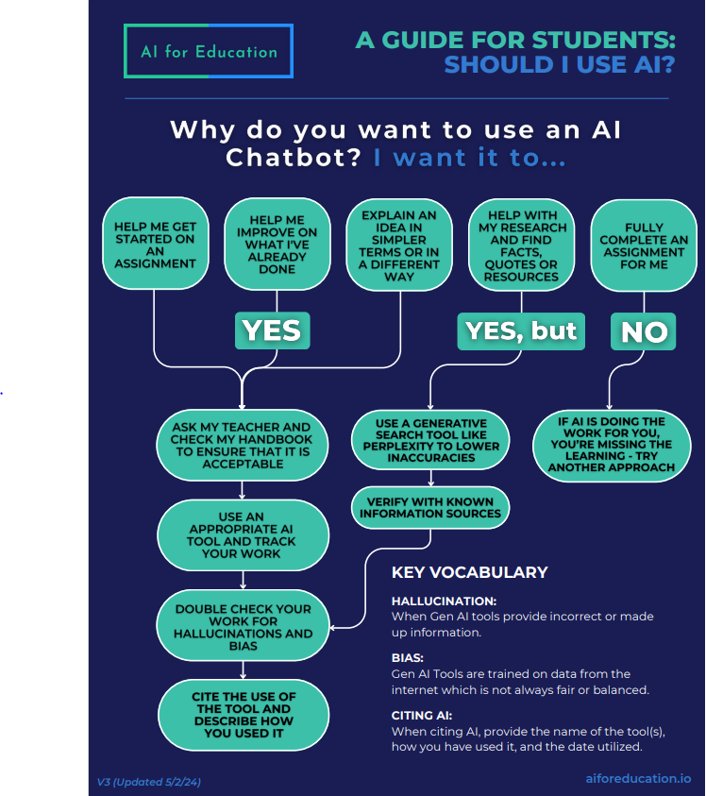
Students and AI: To Use or Not to Use; That is the Question
https://www.aiforeducation.io/home/#ResourceCenterHPanchor

Slide 14
CHAT GPT
Responsible Student Use
Generate ideas or outlines
Practice questions, quizzes
Understand difficult topics
Review drafts
https://chatgpt.com/
Instructor Use
Draft lesson plans, quizzes, rubrics
Summarize articles and readings
Polish prompts, directions
Differentiate learning content

Slide 15
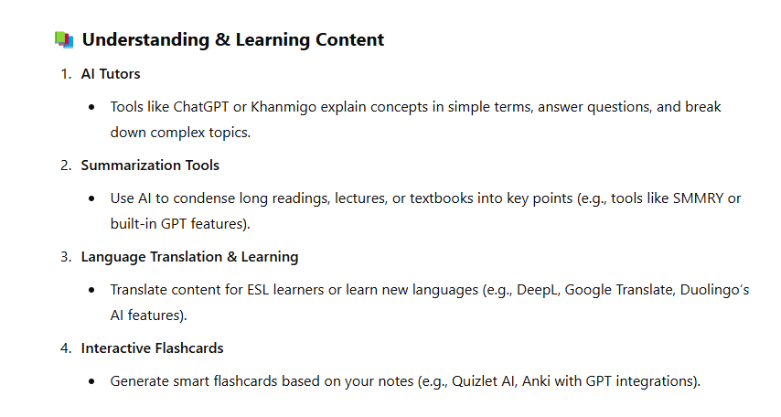
Best Study Tools Via AI Input
"List Best Study Tool Uses for AI" prompt. ChatGPT, 8 Apr. version, OpenAI, 8 April 2025 chat.openai.com/chat. https://chatgpt.com/share/67f84068-acf0-8010-85bf-4ebe12835cf7

Slide 16
Study Tools
Notes
Flashcards
Quizzes
Podcasts
Example
TurboLearn AI
How Emotions Work-Video
Using TurboLearn as Resource

Slide 17
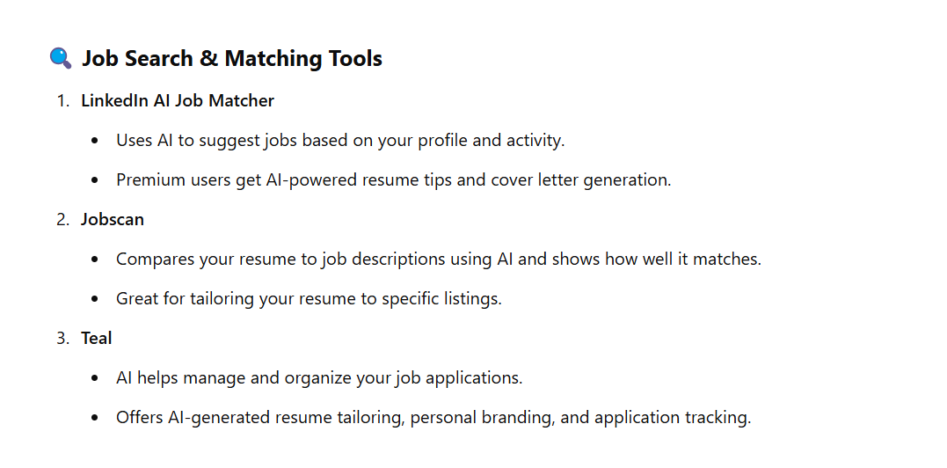
Best Career Tools Via AI Input
"Best AI Career Tools" prompt. ChatGPT, 10 Apr. version, OpenAI, 10 April 2025 chat.openai.com/chat. https://chatgpt.com/share/67f87d76-65fc-8010-af54-c315b627fbc9

Slide 18
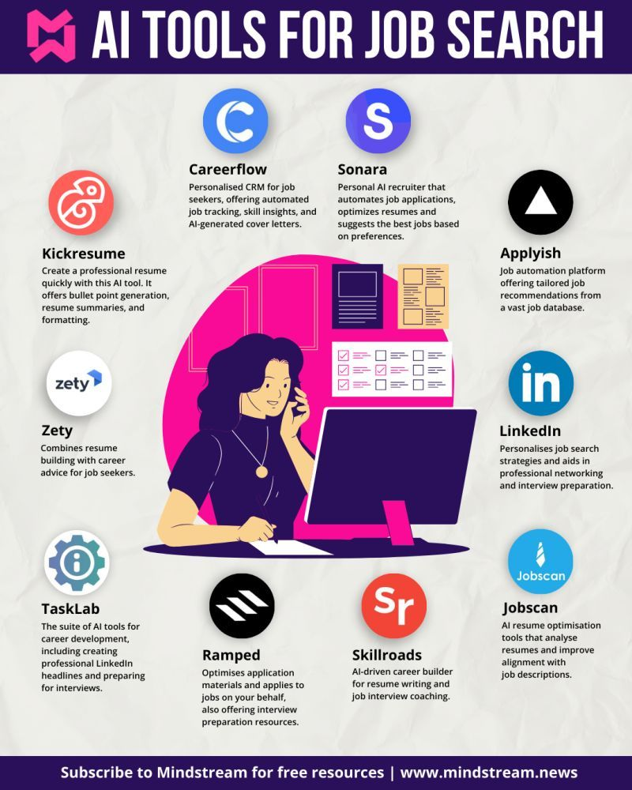
AI Career Tools
AI resume builders to help draft and format your resume
AI job matching tools to help you find good-fit roles
AI resume optimization tools to tailor your resume for specific roles
AI cover letter generators to write a cover letter draft
GPT Google Sheets add-on to personalize networking at scale
Zapier workflows to automatically draft emails
AI-powered interview coaching tools for interview practice and feedback
AI-powered negotiation tools to get the best offer
Zapier Central to build an AI job search bot
Your brain for being a human

Slide 19
Why We Need to
Take This Seriously

Slide 20
Best Practices
• Always fact-check AI output
• Use AI as a starting point, not the final work
• Teach effective prompting
• Encourage ethical and critical use
Student Guide to AI

Slide 22
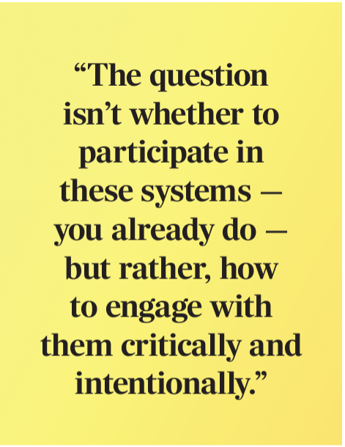
Questions Welcome!
If you would like additional resources, feel free to contact me!
Michelle Pierson
piersonm@mccc.edu
AI Fun
Session Evaluation​

Slide 24
Helpful Resource Links
Presentation
AI for Everyone: The Basics of Supporting Educators and Learners through AI-4.11.25
For Further Learning
AI or Not AI-What Students Want
2025 AI Shortlist for Higher Education: 3 Trends to Prioritize in Your Annual Strategy
AAC&U AI Learning
Leveraging Generative AI to Create Free and Open Educational Resources-Webinar
Student and Teacher Resources
Student Guide to Navigating College in the AI Era-AAC&U
AI for Education-Free Resources
Students and AI Libguide
Try It Out
ChatGPT
turbolearnai
The 50 Best AI Tools for 2025
There's an AI for That
Free AI Tools 2025

